Slide 1
Blockchain-Based Land Registration System
CSE7101- Capstone Project
Review-1
Batch Number: 20221CBC(CBC_3)
Under the Supervision of, Dr. Akshatha Y
Dr. Akshatha Y
Assistant Professor
School of Computer Science and Engineering
Presidency University
Roll Number | Student Name
20221CBC0005 | Varsha BR
20221CBC0048 | Sandya KJ
20221CBC0051 | C.Lokesh
Name of the Program: B.Tech
Name of the HoD: Dr. Pravinthraja S
Name of the Program Project Coordinator: Dr. H M Manjula
Name of the School Project Coordinators: Dr. Sampath A K ,Dr Geetha A

Slide 2
Problem Statement Number: PSCS_4
Organization:: Presidency University
Category :SOFTWARE
Problem Description:Current land registration systems are prone to fraud, delays, and lack of transparency.Manual record-keeping leads to disputes and high verification time. Need for a tamper-proof, transparent, and efficient solution.

Slide 3
Content
Problem Statement
Proposed Solution
Objectives
System Architecture
System Requirements
Advantages
Challenges & Solution
Github Link
Conclusion & Future Scope
References

Slide 4
Content (continuation)..
Problem Statement :Current land registration systems are prone to fraud, delays, and lack of transparency. Manual record-keeping leads to disputes and high verification time.Need for a tamper-proof, transparent, and efficient solution.
A solution is needed to:
Blockchain-Based Land Registry
Smart Contracts for Transactions
Decentralized Access & Transparency

Slide 5
Objectives
Legally Enforceable Land Transactions
Role-Based Authentication & Secure Access
Polygon-Based Boundary Verification
Transparent Buyer–Seller Workflow
Secure & Auditable Transactions
Privacy & Interoperability

Slide 6
Literature Survey
Year | Title | Authors | Publication | Merits | Demerits
2025 | Practically of Blockchain in Land Registration (Namibia) | P.Paavo,R.Rodriquez,U.Chigbu | IEEE/MDPI Conference(Land Governance) | Case study proving governance feasibility | Still early adoption oracle/Boundary issue
2024 | Blockchain Based Property Deeds Repository System | R.C.Suganthe et al. | 14th IEEE ICCCNT(IIT Delhi) | Ethereum-based deeds repository | Prototype stage
2024 | Blockchain Registration System Using Blockchain | S.Kumar et al. | IEEE ICAC3N | Smart contracts for ownership transfer | Not integrated with legal overrides
2023 | Smart Land Registration Using Blockchain | S.Rakesh,N.Gargi,P.Hemavathi | IEEE CIISCA | Transparent & tamper-prof registry | Limited scalability

Slide 7
Literature Survey (continuation)..
Year | Title | Authors | Publication | Merits | Demerits
2023 | Secure Land Record Management System using Blockchain | M.S.Shahariar, P.Banik, M.A.Habib | IEEE ICCIT | StrongKYC+hash-based verification | Court/legal modules missing
2022 | Smart Contract Defination for Land Registry in Blockchain | A.Sahai,R.Pandey | IEEE CSNT | Contract modelling for land ownership | Does not address KYC/privacy
2022 | Digitalization of Land Records using Blockchain | S.Mishra,A.Sahoo, M.V.Anand | IEEE conference Proceeding | Blockchain-backend record storage | No GIS/cadastral integration

Slide 8
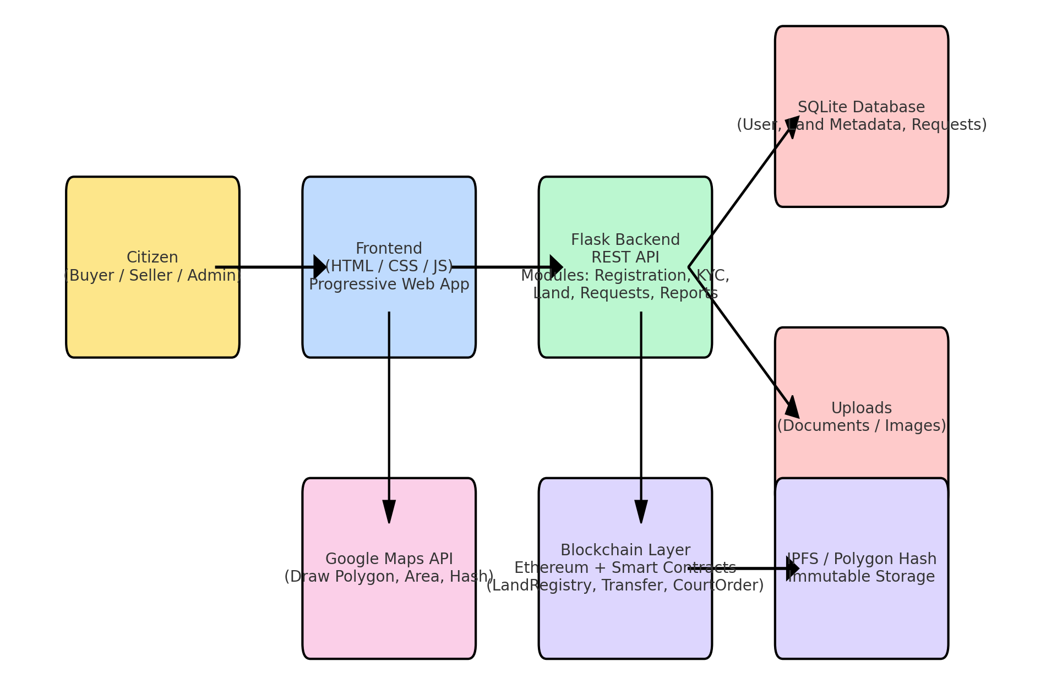
System Architecture

Slide 9
Algorithm Details
Algorithm | Purpose in Project | Explanation | Optimizations Applied | Pseudo-code / Flowchart
SHA-256 / Keccak-256 (Hashing) | Generate tamper-proof hashes for Aadhaar, PAN, KYC docs, land polygon boundaries | Converts input (document/polygon) into a unique 256-bit hash. Used both in backend (Python hashlib) and in Ethereum (Keccak-256). Prevents data alteration. | Store only hashes on-chain (lightweight) while keeping actual files in backend/IPFS → reduces gas cost & blockchain size. | Pseudo-code: \nfunction sha256(data):\n return hash(data)\n Flow: Input → SHA-256 → Fixed-length Hash
ECDSA (Elliptic Curve Digital Signature Algorithm) | Secure signing of blockchain transactions (register land, transfer ownership, payments) | Ensures authenticity – only the private key holder can initiate a land registration/transfer. Uses Ethereum’s secp256k1 curve. | Using MetaMask ensures off-chain signing before broadcasting tx → prevents key exposure in backend. | Pseudo-code: \nsignature = sign(tx_hash, private_key)\nverify(signature, public_key)\n Flow: Tx Data → Hash → Sign (PrivKey) → Verify (PubKey)
Consensus (PoA/PoS in Ethereum) | Ensures only valid blocks are added, preventing double-selling of land | Ethereum consensus validates all smart contract calls (register, pay, transfer). | Using testnets/PoA private chains reduces gas & latency vs. Proof-of-Work. | Flowchart: Tx Submitted → Validators Verify → Block Created → Finalized

Slide 10
Algorithm Details (continuation)..
Algorithm | Purpose in Project | Explanation | Optimizations Applied | Pseudo-code / Flowchart
Merkle Tree (Hash Tree) | Used internally in Ethereum to verify inclusion of transactions in blocks | Every block contains a Merkle Root; ensures land transaction can be verified without entire block download. | Efficient log(n) verification instead of scanning full block data. | Flow: Tx Hashes → Pairwise Hash → Merkle Root
Elliptic Curve Cryptography (ECC) | Generates wallet addresses & key pairs (public/private) | Each Ethereum user (Buyer/Seller/Admin) has a unique wallet derived via ECC. | ECC provides same security as RSA but with smaller key size → faster. | Pseudo-code: \nprivate_key = random()\npublic_key = private_key * G\naddress = keccak256(public_key)\n
AES (Optional – Encryption) | For secure storage of Aadhaar/PAN before uploading to IPFS/backend | Encrypts documents locally, ensuring even backend can’t read raw data. | Encrypts documents locally, ensuring even backend can’t read raw data. | Flowchart: File → AES Encrypt → IPFS Upload; Decrypt only with key.

Slide 11
Advantages
High security & transparency.
Reduced fraud & paperwork.
Immutable transaction history.
24/7 accessibility from anywhere.

Slide 12
Challenges & Solutions
Challenge | Solution
High Gas Fees | Use private blockchain(permissioned Ethereum/Hyperledger) or Layer-2 scaling solutions (Polygon , optimism) to reduce transaction costs.
User Adoption | Provide training sessions , awareness workshops, and design an easy-to-use Web/mobile UI With local language support.
Large File Storage | Store only Hashes (SHA-256/IPFS CID) on blockchain and keep actual files (KYC docs , cadastral maps, images) in IPES/cloud storage.
Legal Enforceability | Introduce a Court Order Module allowing authorized government officers to override or correct records while preserving audit trails.
Boundary Verification | Use Google Maps API & Polygon Hashing for cadastral boundary verification before transfers.

Slide 13
Challenges & Solutions (continuation)..
Solution | Challenges
Privacy of Owner Data | Implement Selective Disclosure Proofs and encrypt sensitive KYC details off-chain
Interoperability with Govt . Systems | Build adapters to connect blockchain registry with tax APIs. E-stamp , and land ceiling compliance system

Slide 14
Github Link
The Github link provided should have public access permission.
Github Link
https://github.com/Sandyakj48/Capstone_PSCS_611

Slide 15
Conclusion & Future Scope
Can integrate with government databases for real-world adoption.
Potential to expand into multi-country land management systems.
Future integration with AI for fraud detection.

Slide 16
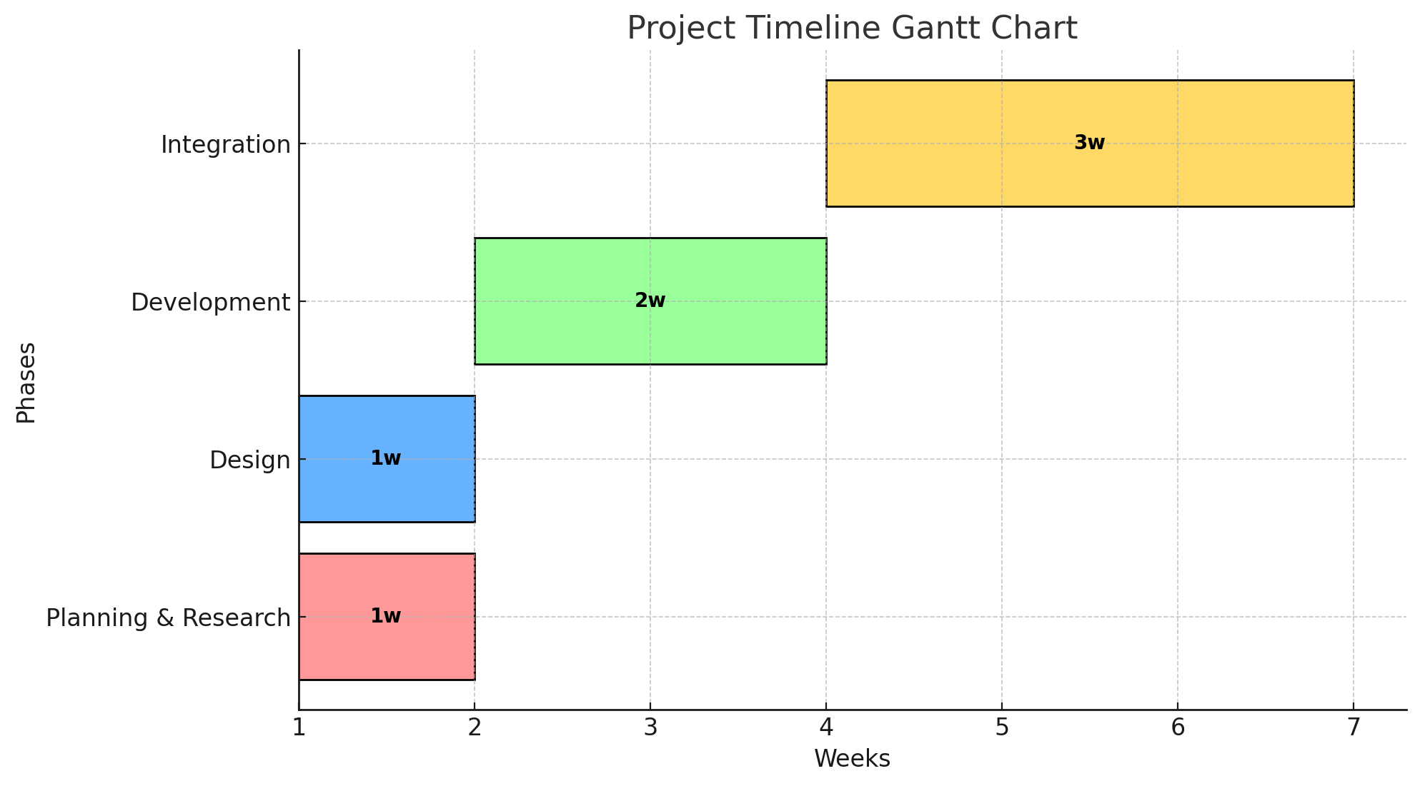
Timeline of the Project

Slide 17
References (IEEE Paper format)
S. Rakesh, N. Gargi, and P. Hemavathi, “Smart Land Registration Using Blockchain,” in Proc. 2023 Int. Conf. on Computational Intelligence for Information, Security and Communication Applications (CIISCA), IEEE, 2023, pp. 194–199. [Online]. Available: https://www.computer.org/csdl/proceedings-article/ciisca/2023/397200a194/1U1rXSGFxQc
Sahai and R. Pandey, “Smart Contract Definition for Land Registry in Blockchain,” in Proc. 2020 IEEE 9th Int. Conf. on Communication Systems and Network Technologies (CSNT), IEEE, 2020, pp. 191–196. [Online]. Available: https://www.jetir.org/papers/JETIR2106234.pdf
S. Mishra, A. Sahoo, and M. V. Anand, “Digitalization of Land Records using Blockchain Technology,” in Proc. 2021 IEEE Conf. on Innovations in Information Systems and Advanced Engineering (IJISAE), IEEE, 2021. [Online]. Available: https://ijisae.org/index.php/IJISAE/article/view/6913
M. S. Shahariar, P. Banik, and M. A. Habib, “A Secure Land Record Management System using Blockchain Technology,” in Proc. Int. Conf. on Computer and Information Technology (ICCIT), IEEE, 2022. [Online]. Available: https://arxiv.org/abs/2304.13512
S. Kumar et al., “Land Registration System using Blockchain,” in Proc. 2023 5th Int. Conf. on Advances in Computing, Communication, Control and Networking (ICAC3N), IEEE, 2023. [Online]. Available: https://www.grafiati.com/en/literature-selections/land-registration
R. C. Suganthe et al., “Blockchain Based Property Deeds Repository System,” in Proc. 14th Int. Conf. on Computing, Communication and Networking Technologies (ICCCNT), IEEE, 2023. [Online]. Available: https://www.researchgate.net/publication/375882892_Blockchain_Based_Property_Deeds_Repository_System

Slide 18
References (IEEE Paper format)
M. N. Uddin, M. R. Islam, and M. S. Hossain, “Blockchain Based Land Registration System for Bangladesh,” in Proc. 2019 Int. Conf. on Electrical, Computer and Communication Engineering (ECCE), IEEE, 2019, pp. 1–6. [Online]. Available: https://ieeexplore.ieee.org/document/8679305
R. Sharma, V. Bansal, and R. Mahajan, “Blockchain based Secure Land Registry System,” in Proc. 2021 5th Int. Conf. on Intelligent Computing and Control Systems (ICICCS), IEEE, 2021, pp. 1605–1610. [Online]. Available: https://ieeexplore.ieee.org/document/9498730
N. K. Gupta and P. Agarwal, “Land Record Management Using Blockchain Technology,” in Proc. 2020 11th Int. Conf. on Computing, Communication and Networking Technologies (ICCCNT), IEEE, 2020, pp. 1–7. [Online]. Available: https://ieeexplore.ieee.org/document/9225435
S. A. Bhosale and V. R. Pawar, “Blockchain Based Land Registration and Property Transfer System,” in Proc. 2022 Int. Conf. on Computing, Communication, and Intelligent Systems (ICCCIS), IEEE, 2022, pp. 453–458. [Online]. Available: https://ieeexplore.ieee.org/document/9754134
P. K. Sharma, J. H. Park, and S. Rathore, “Efficient Management of Land Records Using Blockchain in Smart Cities,” IEEE Access, vol. 7, pp. 114–124, 2019. [Online]. Available: https://ieeexplore.ieee.org/document/8636509

Slide 19


